Slide 1
RUST-NATIVE AGENTIC PLATFORM ENGINEERING WITH EMBEDDED MCP
Presenter: Jeffrey Aven
STACKQL>>
Notes:
Three things today:
StackQL in five minutes
what changes when agents write to your estate
and how to embed the MCP server in a Rust binary

Slide 2
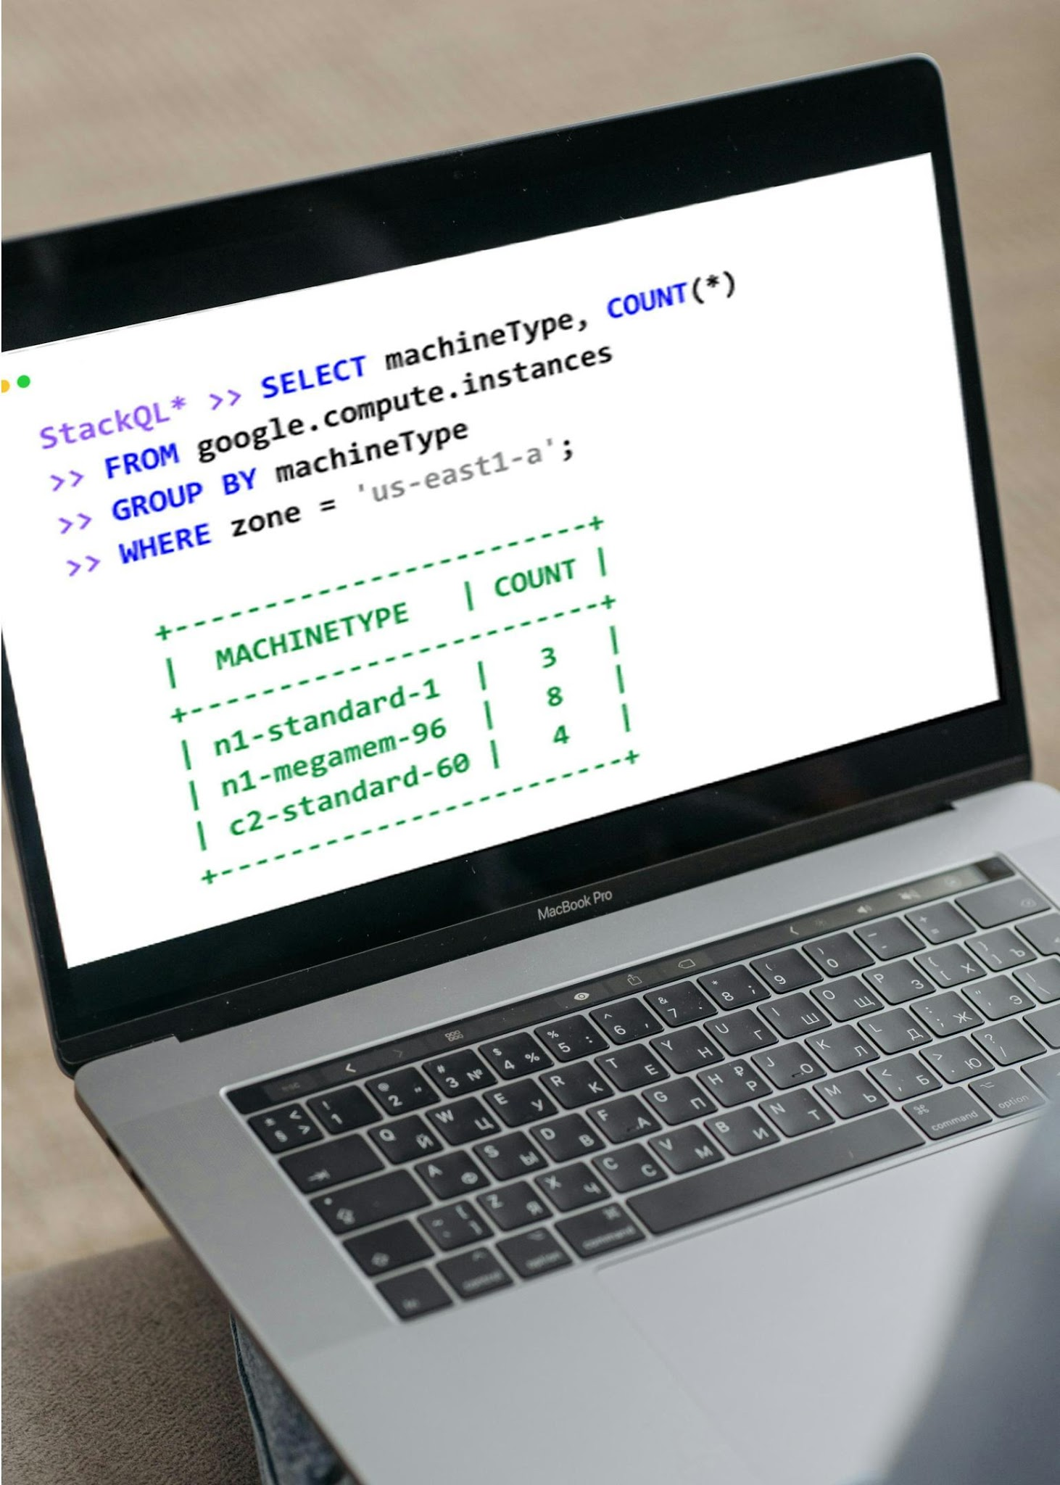


STACKQL >>
Unified Cross-Plane Analytics, Automation and IaC
Query and Interact in Real
Time using SQL
Seamless Integration with
Existing Systems
Analyst Friendly, Agent Native
CONFIGURATION-AS-DATA
INFRASTRUCTURE-AS-CONTEXT
STACKQL>>
Notes:
Cloud and SaaS providers as data sources accessed via SQL.
Query and change live state.
No server, no database, no state file: the engine calls the provider APIs at query time.

Slide 3

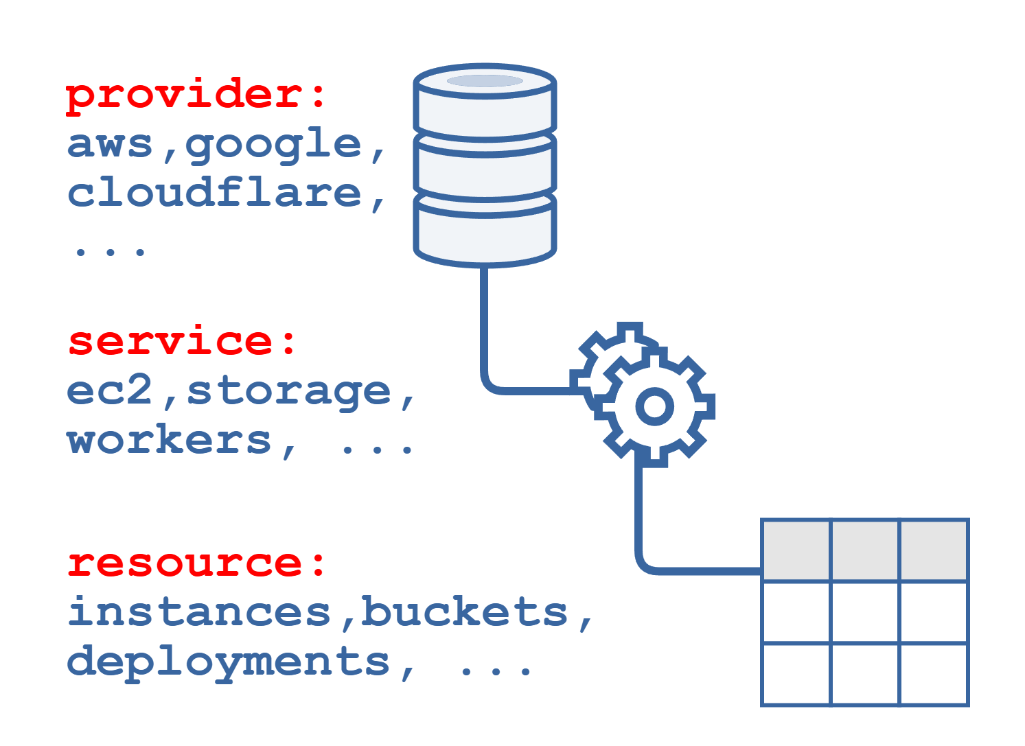
Cloud Providers as Data Sources
Open-Source intelligent API client
Protocol Agnostic
DAG planning for remote and local execution
SQL semantics for Cloud/SaaS Provider APIs
Relational algebra, analytics
CRUD, Discovery and Lifecycle Methods
STACKQL>>
Notes:
Providers are OpenAPI-derived interface documents pulled from a registry; 40+ providers, community extensible.
SELECT for reads, INSERT/UPDATE/REPLACE/DELETE for writes, EXEC for lifecycle methods.
The planner builds a DAG: remote calls where it must, local relational work (joins, aggregates, SQLite functions) where it can.

Slide 4




How to use StackQL
One execution engine. Multiple human/agent consumption patterns.
PATTERN |  | INTERFACE | USERS | KEY BENEFIT
 | Interactive Analytics | stackql shell stackql exec | Engineers, Analysts | Ad-hoc discovery, inventory
 | Application & Data Integration | stackql srv docker pull pystackql | Apps, BI Tools, Python Workloads | Application access to Cloud and SaaS APIs
 | Platform Automation | stackql-deploy Marketplace GitHub Actions | Platform & DevOps Teams | Declarative automation and IaC
 | Agentic Operations | MCP (uv, pip, npx, docker, mcpb) | AI Agents & Agent Frameworks | Context-aware cloud operations
STACKQL>>

Slide 5
AGENTIC PLATFORM OPS
Platform Engineering, XOps, and SRE in the Agent Era
STACKQL>>
Notes:
why does any of this matter for platform engineering, SRE, XOps?
Because agents are about to become writers to your estate, and the tooling assumes they are not.

Slide 6

IaC/PLATFORM OPS IN THE AGENT ERA
Agents AND humans
author changes.
Humans author the changes.
Changes at human timescales.
Changes at machine speed.
One writer per environment.
Multiple writers, at the same time.
Drift is an exception.
Drift is the default state.
STACKQL>>
Notes:
IaC was based upon four assumptions, all of which were reasonable ten years ago, now all inverted.
Humans authored the changes.
Changes happened at human timescales, which is to say minutes to days.
One writer per environment, enforced by review and state locking.
And drift was an exception, something you fixed and then went back to the steady state.
A state file is a snapshot of one writer's belief.
With multiple writers it is wrong by construction.

Slide 7
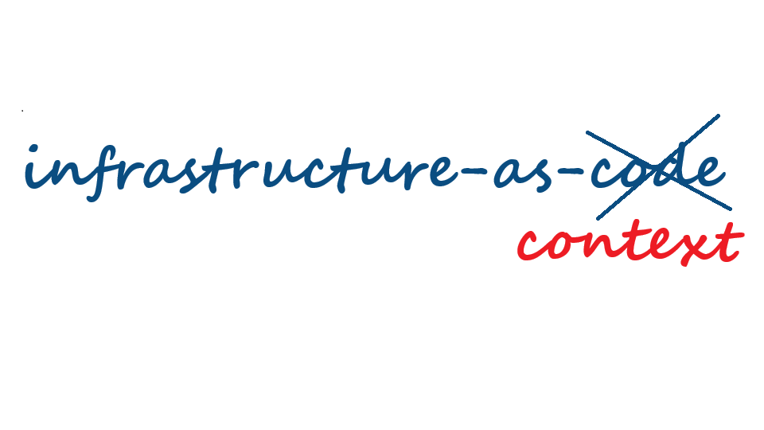
IaC IN THE AGENT ERA
STACKQL>>
Notes:
The agent's context has to be the running estate, not a plan file.

Slide 8
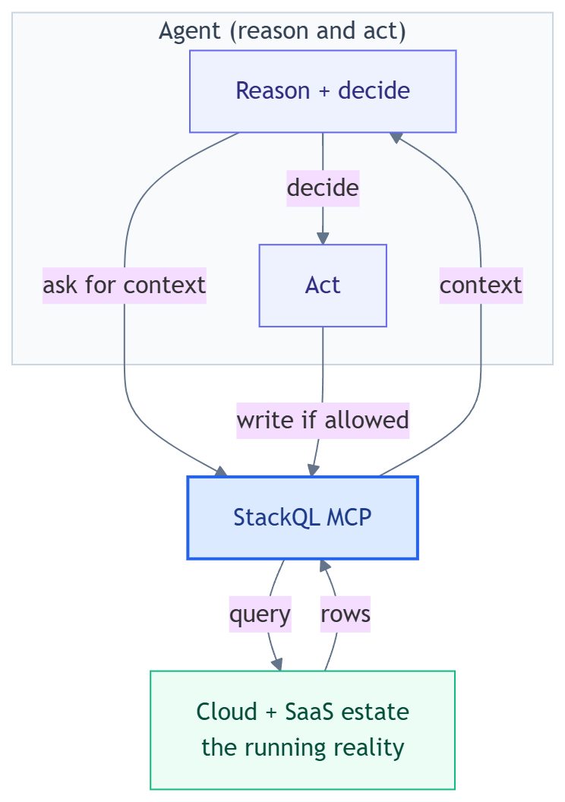
THE NEW CONTRACT
Agents need to query, reason about, and act on actual state.
Static state and state files are artefacts of slow infrastructure.
STACKQL>>
Notes:
with Infrastructure-as-Code: the intent lived in the code.
with Infrastructure-as-Context: agents need to query, reason about, and act on actual state.
Code does not disappear. It - along with the state file - just stops being the contract.

Slide 9
STACKQL MCP
The agent interface to the StackQL execution engine
STACKQL>>
Notes:
The agent interface to the engine. Same SQL, served over MCP.

Slide 10
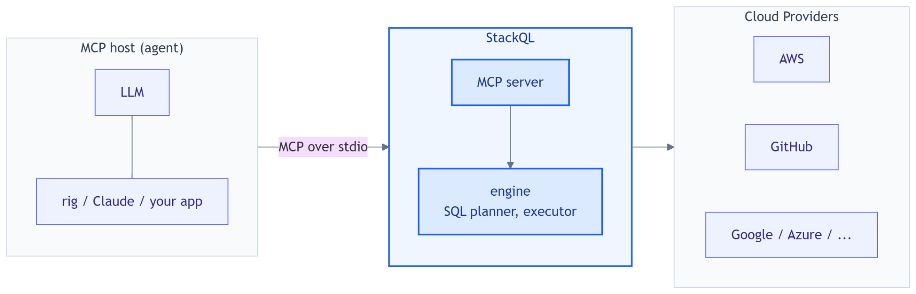
WHAT THE STACKQL MCP SERVER IS
Unified SQL surface over every cloud and SaaS provider.
STACKQL>>
Notes:
One MCP server, one SQL surface, every provider. Instead of N bespoke tool servers with N auth schemes.
Runs over stdio or HTTP; the host here is our own Rust app, but it is the same server Claude Desktop, Cursor, npx and uvx users run.
Credentials stay server-side in the process environment; the model never sees them.

Slide 11
STACKQL MCP TOOL SURFACE
One MCP, one set of tools, instead of 10s or 100s
Discovery: list_providers, list_services, list_resources, describe_resource, describe_method, list_methods, list_registry, pull_provider, server_info
Query (reads): run_select_query, validate_select_query
Change (writes): run_mutation_query, run_lifecycle_operation
changes gated through server modes: read_only (default), safe & delete_safe (uses elicitation), full_access
all tool use is logged by the stackql mcp server
STACKQL>>
Notes:
Discovery tools let the model drill provider -> service -> resource -> methods before writing SQL, so it does not guess table names.
Modes are a server-side contract: `read_only` refuses writes however the model is prompted; `safe` and `delete_safe` send an MCP elicitation request and wait for a human; a client that cannot answer gets a refusal. `full_access` is the explicit opt-in.
Every tool call is audited as JSONL (SQL, decision, duration; never result rows).

Slide 12
EMBEDDED MCP WITH RUST
MCP execution, embedded directly into Rust applications
STACKQL>>
Notes:
Normal MCP topology: a server you deploy and operate, clients connect to it.
Fine for shared capability, wrong for software you hand to someone else.
With embedded MCP the app owns the server lifecycle. Acquire, spawn as a child, handshake, hand back a client.
The server becomes an implementation detail.

Slide 13
SIDECAR VS VENDORED
Two ways to acquire the server.
 |  | Sidecar (default feature) | Vendored (vendored feature)
How the server arrives |  | downloaded at first run, for the release pinned in the crate | fetched at build time, compiled in with include_bundle!()
Integrity |  | sha256 checked against pins rendered from the release | the bytes are the artefact
First run |  | download, verify, extract, cache | extract from the binary into the same cache, launch
Network at run time |  | first run only (to pull from crates.io) | never
Artefact size |  | the app | app + ~40 MB (linux, windows)
Choose when |  | many apps on one host, one cached server | one-file distribution
STACKQL>>
Notes:
Same builder, same connected client, one line of difference. You pick at build time.
Sidecar: the crate carries sha256 pins rendered from the release; first run downloads that exact bundle from releases.stackql.io, verifies, caches. Cache is shared with the npm and PyPI wrappers, so a polyglot host downloads once.
Vendored: bundle fetched at build time and compiled in; nothing to download, one file to ship.

Slide 14
SIDECAR DETAILED
Cargo update and builder call to a connected MCP client.
what start()does…
# Cargo.toml
[dependencies]
stackql-mcp = "0.10" # sidecar is the default feature
tokio = { version = "1", features = ["macros", "rt-multi-thread"] }
serde_json = "1"
// main.rs
use stackql_mcp::{Mode, StackqlMcp};
#[tokio::main]
async fn main() -> anyhow::Result<()> {
let server = StackqlMcp::builder()
.mode(Mode::ReadOnly) // writes refused server-side
.start() // acquire, verify, spawn, handshake
.await?; // -> a connected rmcp client
let tools = server.list_all_tools().await?; // 16 StackQL tools
server.shutdown().await?;
Ok(())
}
cached? ~/.stackql/mcp-server-bin/<ver>/<os>/
No
Yes
download .mcpb from releases.stackql.io, verify sha256 against the pin in the crate
spawn stackql mcp over stdio, MCP initialize
RunningServer: a connected rmcp client list_all_tools(), call_tool(), shutdown()
STACKQL>>
Notes:
cache check, download and verify on a miss, spawn `stackql mcp` over stdio, MCP initialize, and you get rmcp's `RunningService` back.
rmcp is the official Rust MCP SDK; tokio is the async runtime that drives the child's stdio.
Escape hatches: `STACKQL_MCP_BIN`, `STACKQL_MCP_BUNDLE`, `Builder::command()` for bring-your-own MCP stack (steward uses it to answer approval prompts).

Slide 15
VENDORED DETAILED
what
cargo build --features vendored
does...
Same program, server compiled in
# Cargo.toml
[dependencies]
stackql-mcp = { version = "0.10", features = ["vendored"] }
[build-dependencies]
stackql-mcp = { version = "0.10", features = ["sidecar"] } # for build.rs
// build.rs: fetch the pinned bundle once for include_bundle!()
fn main() {
let path = stackql_mcp::fetch_bundle().unwrap();
println!("cargo:rustc-env=STACKQL_MCP_BUNDLE_FILE={}", path.display());
}
// main.rs: identical to the sidecar program, plus one line
let server = StackqlMcp::builder()
.mode(Mode::ReadOnly)
.bundle_bytes(stackql_mcp::include_bundle!()) // <- the only change
.start()
.await?;
build.rs: fetch_bundle() downloads the .mcpb from releases.stackql.io, verifies sha256, once
include_bundle!() compiles the bytes in: one binary, app + StackQL engine
extracted? ~/.stackql/mcp-server-bin/vendored/
no -> extract
yes
spawn stackql mcp over stdio, MCP initialize RunningServer: a connected rmcp client
STACKQL>>
Notes:
`build.rs` calls `fetch_bundle()` once at build time, and `include_bundle!()`. `include_bytes!` is a language feature
First run extracts from the binary into the same cache and starts.
`STACKQL_MCP_BUNDLE_FILE` to embed a bundle you already have.

Slide 16
DEMO
STACKQL>>

Slide 17



CLOUD
COMPLIANCE
SECURITY
MCP
AUTOMATION
ASSURANCE
THANK YOU
STACKQL>>
stackql.io

